Slide 1

ALL IN one grocery store
Rajat Bhardwaj (PIET16CE086) Guide Name : Dr. Ajay Maurya
Ravneet Singh (PIET16CE089)
Vaidehi Kalra (PIET16CE113)

Slide 2
Abstract:
All In One Grocery Store is a web application that provides various types of groceries at one place. It has two kinds of users. One of them is the admin who handles all the products, product categories and quantity of products which displays on customer view. Another user is the customer who buys products.
The basic idea of this website is to satisfy all the grocery needs of customers at one place. This website allows a customer to yield orders for products from a store or its outlet. It provides services for both self-pickup and at-home delivery. Customers have to provide their address and complete details of their contact and with this information they can get their order at home.
Hence, this is time saving web application.

Slide 3


Slide 4
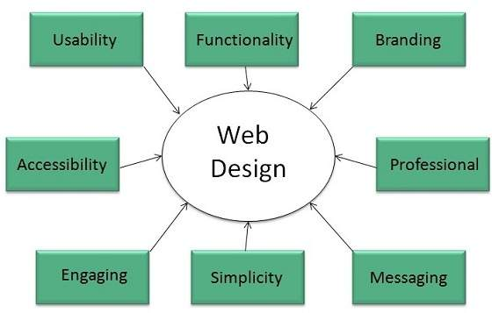
What is Website designing?
Web Development in a big term for the work involved in developing a website for internet.
Website Design encompasses many different skills and disciplines in the production, development and maintenance of websites.
Web designing has direct link to visual aspect of a web site. Effective web design is necessary to communicate ideas effectively.
While designing a website the things that need to be taken in considerations are like usability, functionality, simplicity, accessibility, branding, etc.

Slide 5
Steps for effective website design
Analyse
Information/Content
Target Audience
Organise
Navigation
Content
Page Layout
Page Design
Develop
Web page layout
Site layout
Web page construction
Implement
UI
Final Checklist
Maintain
Marketing
Optimisation
Traffic Analysis

Slide 6
Website development tools and languages
HTML(Hyper Text Markup Language)
Bootstrap
JavaScript
jQuery
PHP
CSS (Cascading Style Sheets)
MySQL
Sublime Text
Xampp

Slide 7
Bootstrap
Bootstrap is the most popular front end framework in the recent time. It is sleek, intuitive, and powerful mobile first front-end framework for faster and easier web development. It uses HTML, CSS and JavaScript.
It is supported by all popular browsers like Chrome, Firefox, Opera, Safari, Internet Explorer, etc. With just the knowledge of HTML and CSS anyone can get started with Bootstrap. Also the Bootstrap official site has a good documentation.
Bootstrap is famous for being developed with components that have the ability to follow the property of responsive designs
Responsive Design is about using CSS and HTML to resize, hide, shrink, enlarge, or move the content to make it look good on any screen
Responsive Design allow your page works for computer, tablets and mobile phones.

Slide 8
php
PHP is an acronym for "PHP: Hypertext Preprocessor“ which is a server scripting language, and a powerful tool for making dynamic and interactive Web pages. It is widely-used, free and efficient alternative to competitors such as Microsoft's ASP.
PHP files can contain text, HTML, CSS, JavaScript, and PHP code. Its code is executed on the server, and the result is returned to the browser as plain HTML.
It is amazing and a powerful language as:
It is powerful enough to be at the core of the biggest blogging system on the web (WordPress).
It is deep enough to run the largest social network (Facebook)
It is also easy enough to be a beginner's first server side language.
It is integrated with a number of popular databases, including MySQL, PostgreSQL, Oracle, Sybase, Informix, and Microsoft SQL Server.

Slide 9
MySql
MySQL is a fast, easy-to-use RDBMS being used for many small and big businesses. MySQL is becoming so popular as:
MySQL is released under an open-source license.
MySQL is a very powerful program in its own right. It handles a large subset of the functionality of the most expensive and powerful database packages.
MySQL uses a standard form of the well-known SQL data language.
MySQL works on many operating systems and with many languages including PHP, PERL, C, C++, JAVA, etc.
MySQL is very friendly to PHP, the most appreciated language for web development.
MySQL supports large databases, up to 50 million rows or more in a table. The default file size limit for a table is 4GB, but you can increase this (if your operating system can handle it) to a theoretical limit of 8 million terabytes.

Slide 10
Need of grocery store web application
You can save time in terms of driving to a physical grocery store, circling the parking lot looking for parking, meandering up and down the aisles, standing in line at the checkout counter, loading the groceries in your car, and driving home.
You are less likely to overspend if you purchase grocery online rather than visit a physical grocery store, because you are less likely to be side tracked and end up buying more than what you intended.
Let's face it: It has happened to all of us. We go to the grocery store with a shopping list and wind up walking out of the store having bought a million other things that were not on the list.
If you have a physical handicap or impairment that prevents you from the physical labor associated with grocery shopping, then having your groceries delivered to you may well be a necessity more than a convenience.
If you live in a building that makes lugging grocery bags up and down a flight of stairs or elevators and down a hallway very difficult, then door-to-door grocery delivery would take care of this problem for you

Slide 11
Need of grocery store web application
If you are extremely strapped for time, either due to your career, your school, a schedule that prohibits you from being able to get to the grocery store before it closes, or because of your family commitments, then you would be able to free up your time to do the things that really matter if you were to purchase grocery online.
You can shop anytime you want at your own convenience, 24 hours a day, 7 days a week.
You can avoid the stress and hassle of having to drive to the grocery store, circle around the parking lot vying for a parking space, dragging your screaming and restless kids with you to the store, meandering through the crowded isles while trying to avoid a collision or traffic jam with other shopping carts, standing in a long line at the checkout counter loading and unloading your car trunk with the groceries when you leave the store and arrive at home.

Slide 12
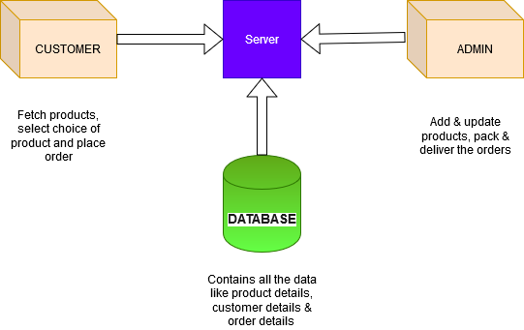
Architecture of the project

Slide 13
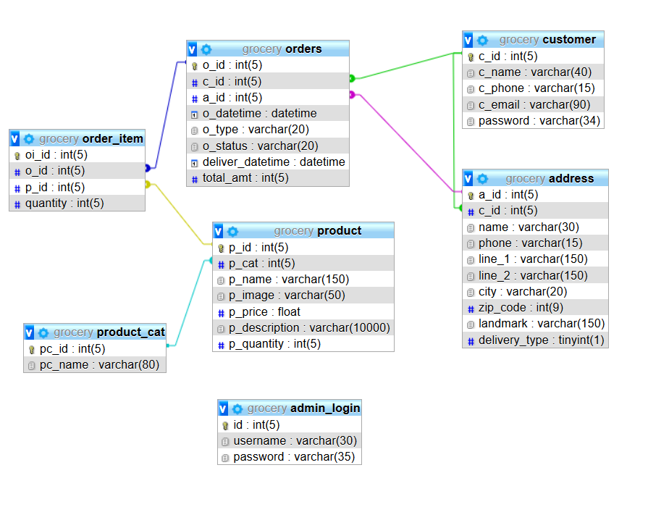
Database schema

Slide 14
Snapshots

Slide 15
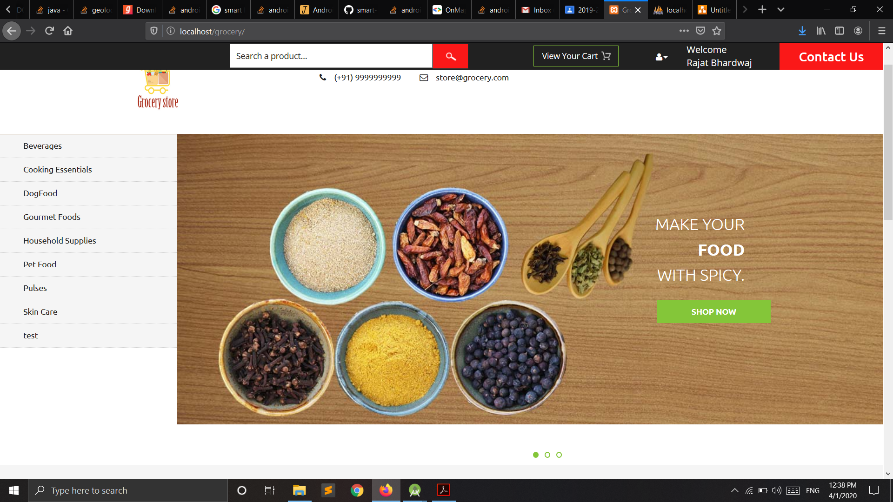
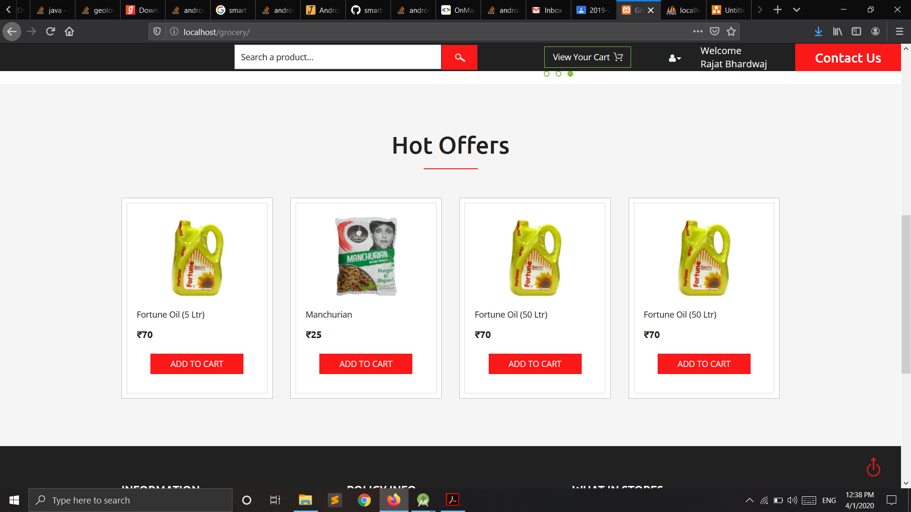
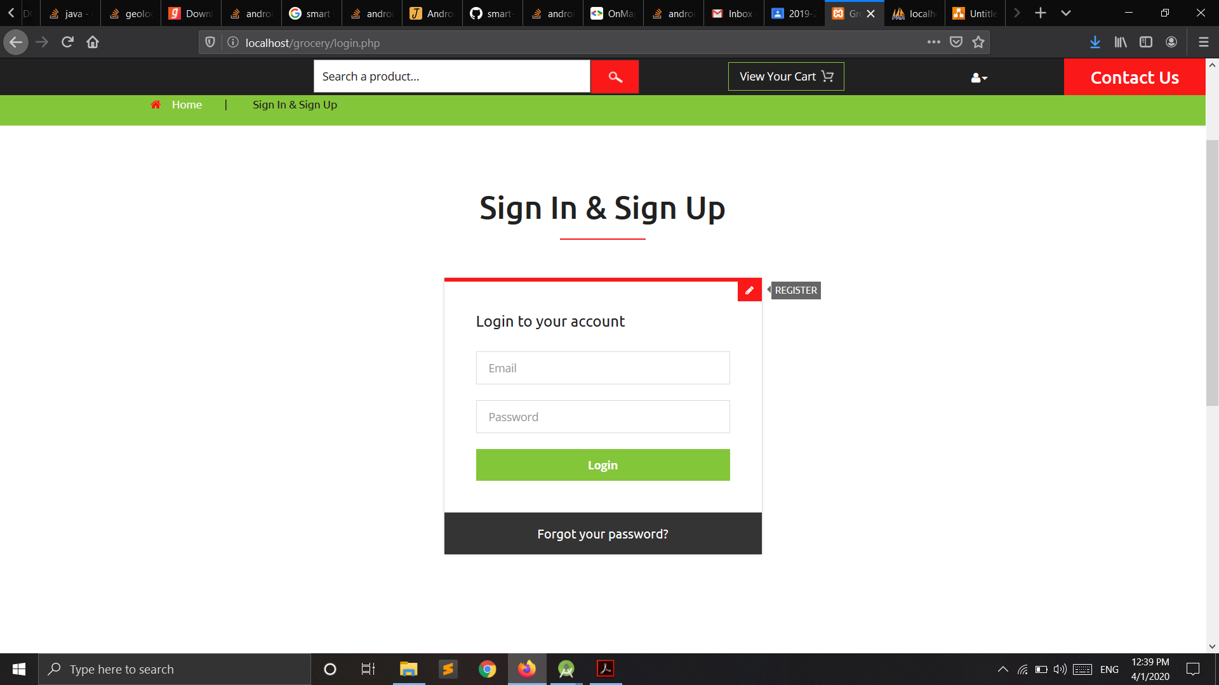
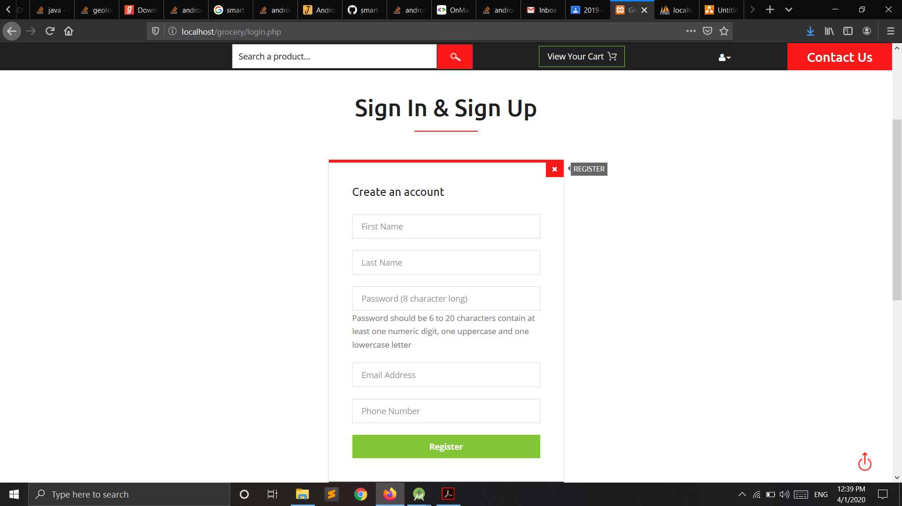

Slide 16
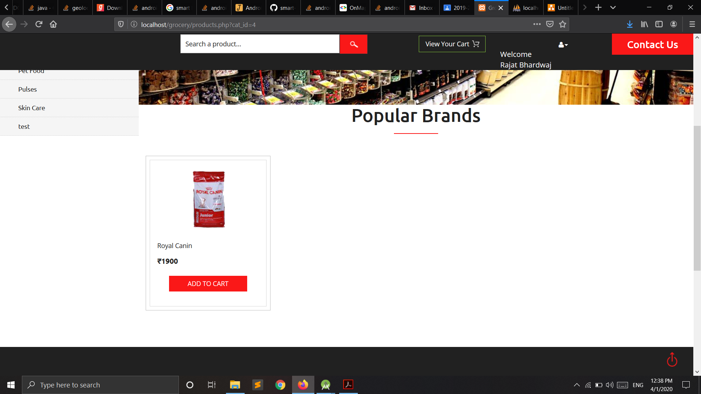
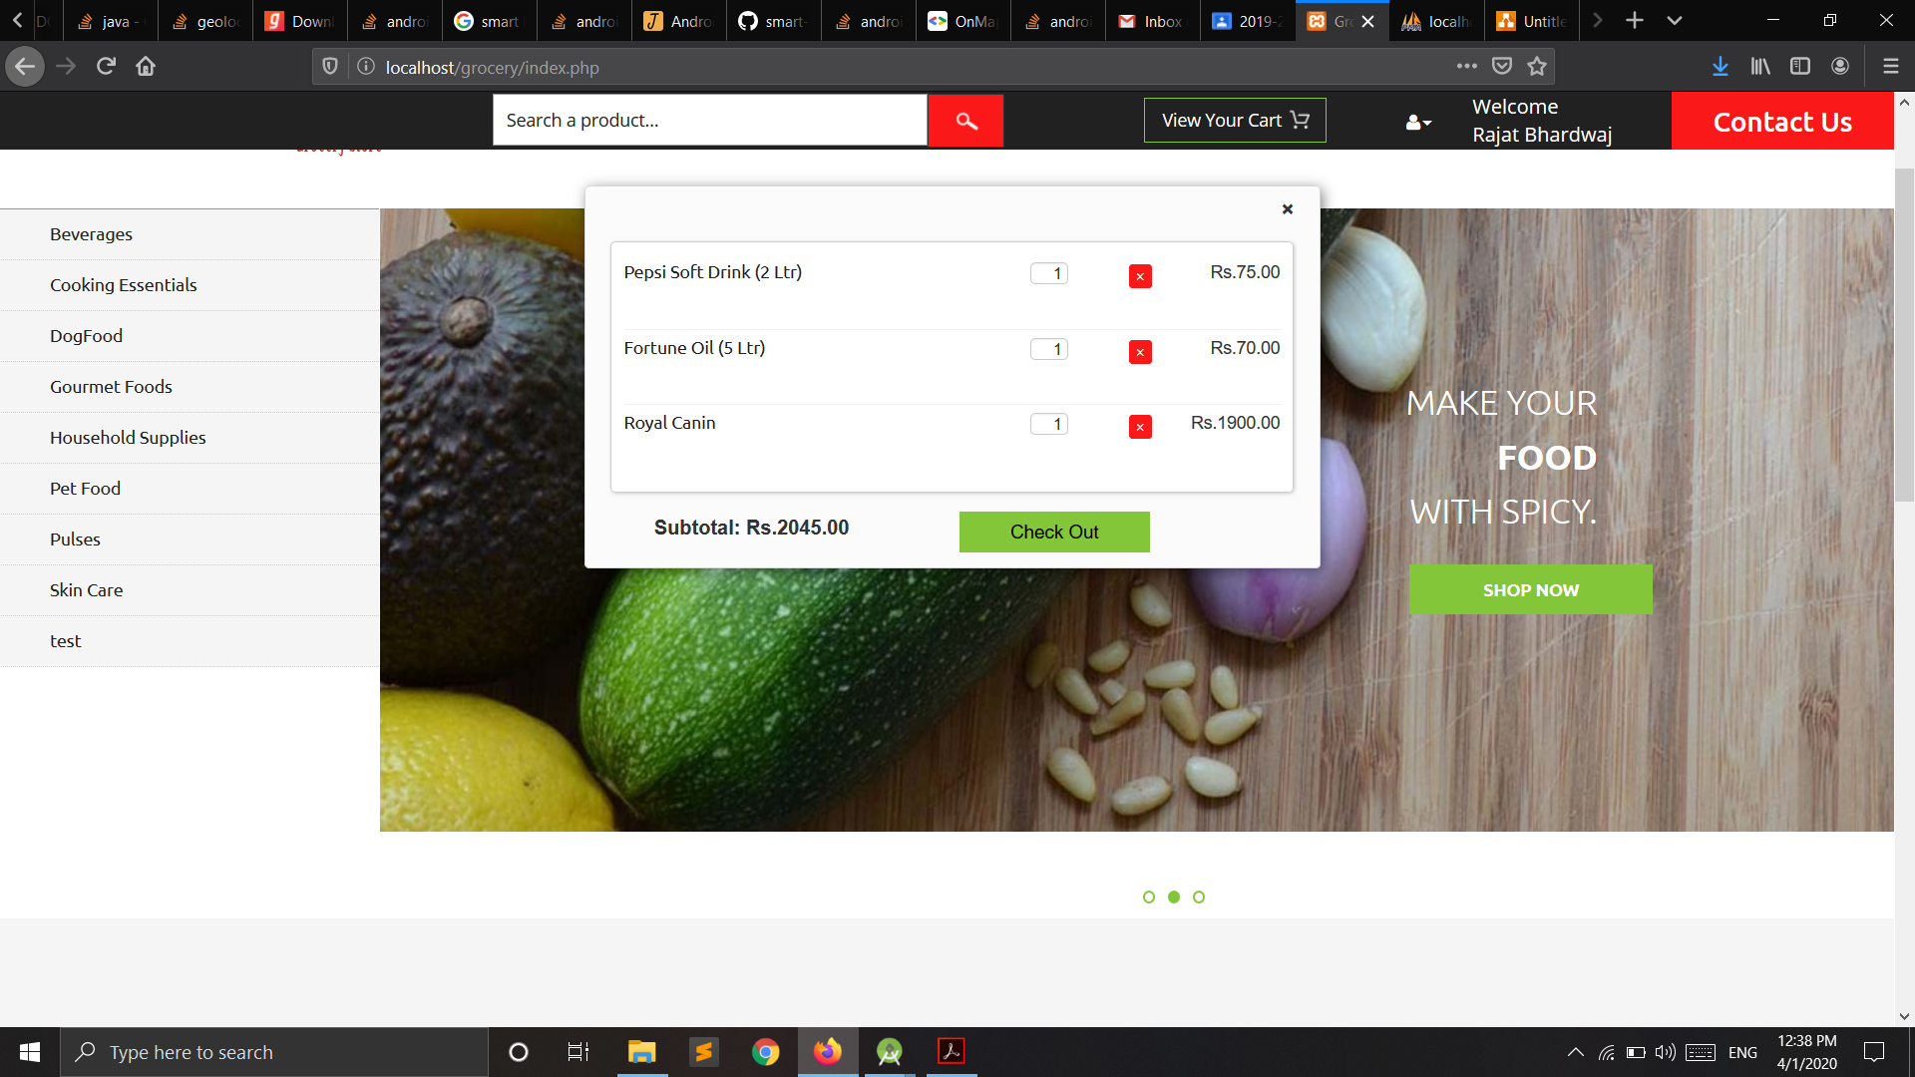
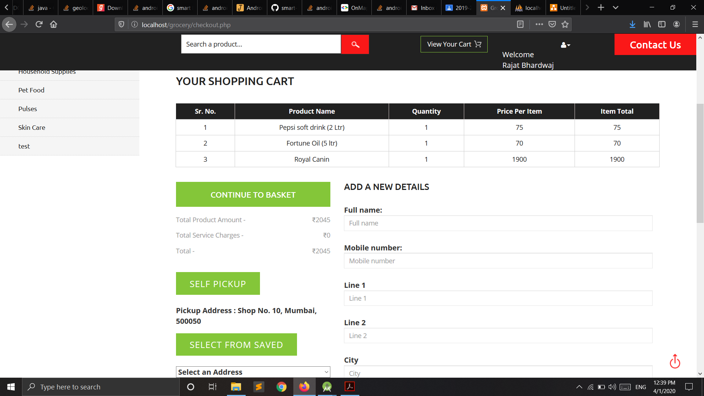
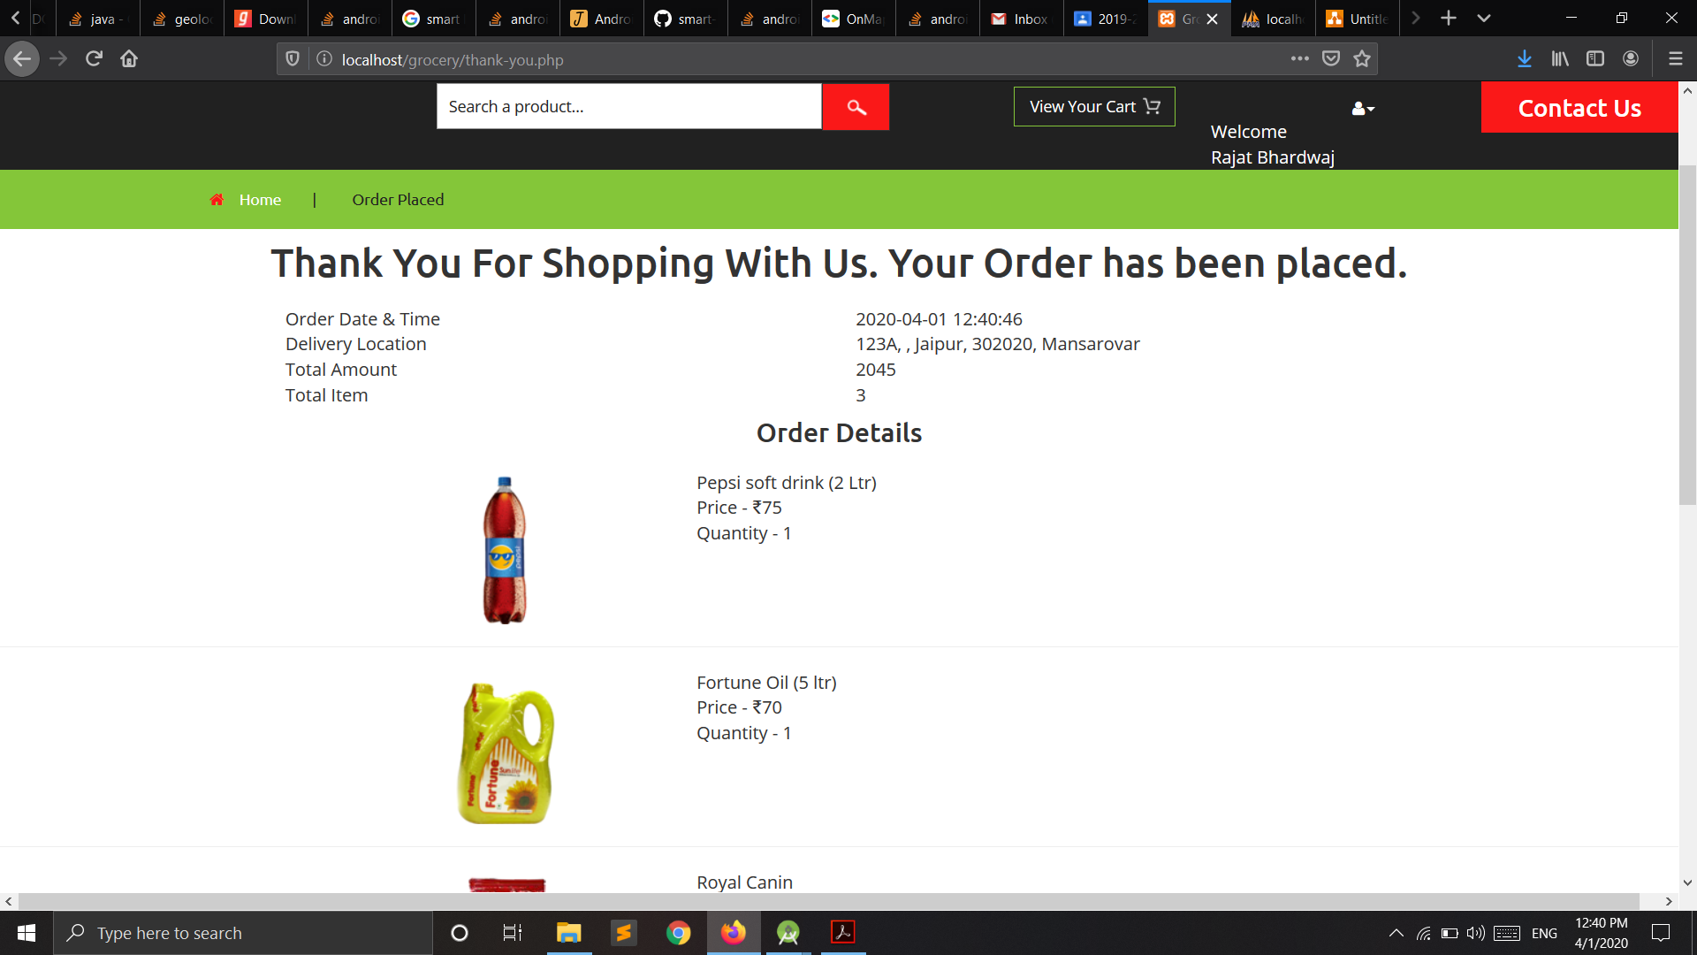

Slide 17
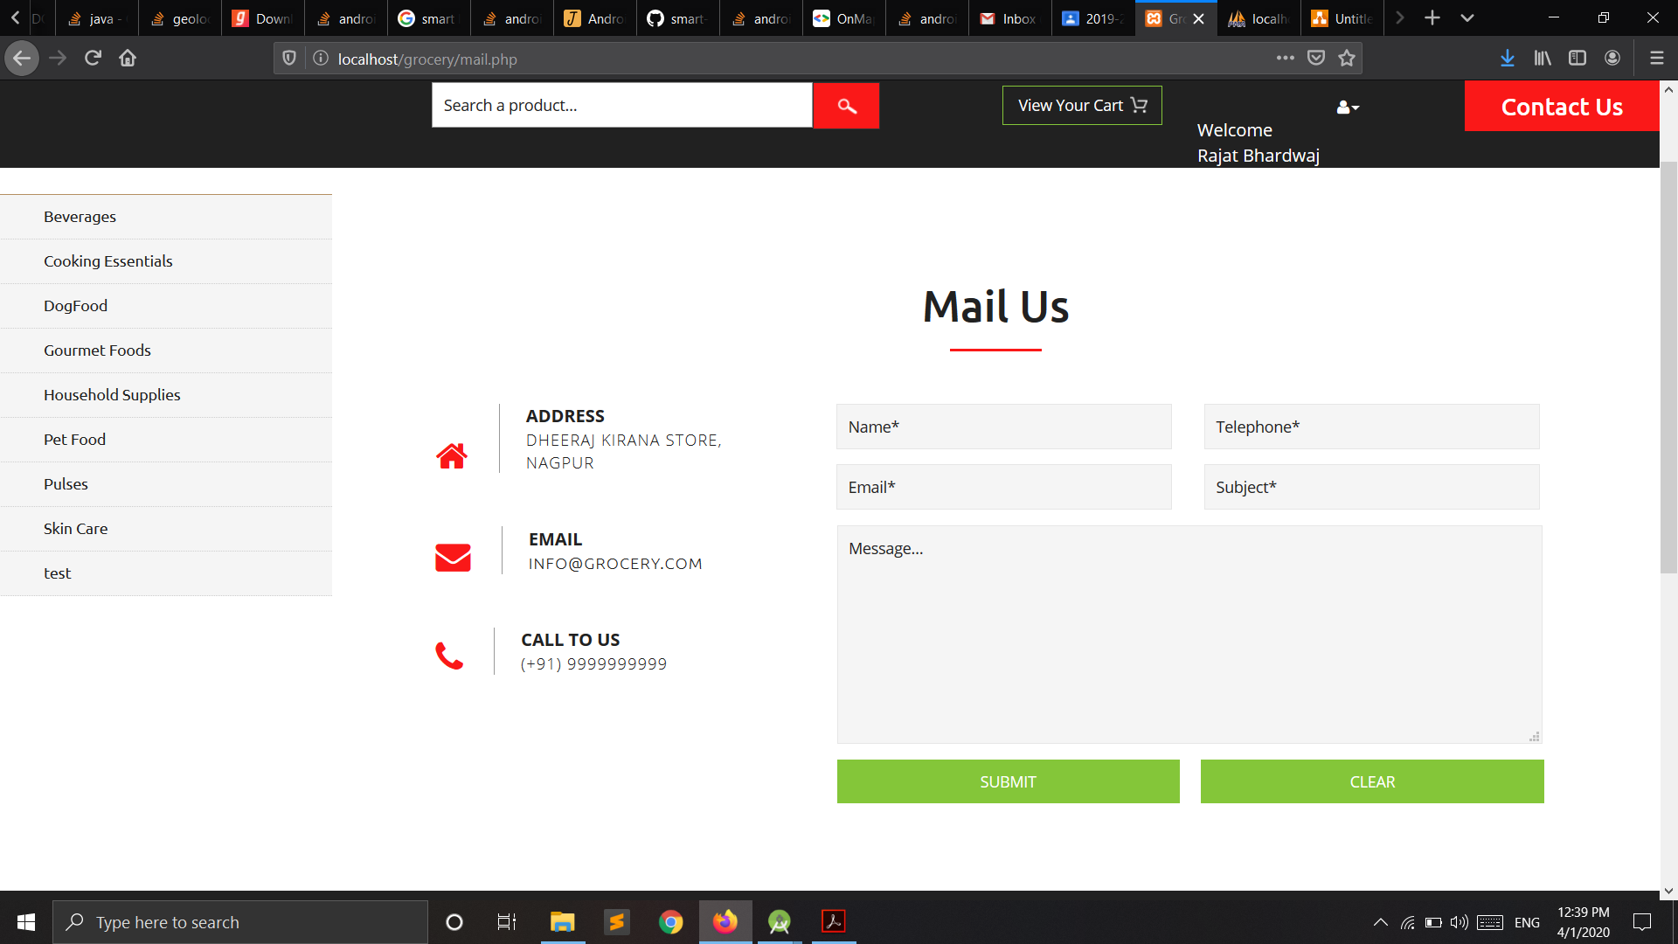
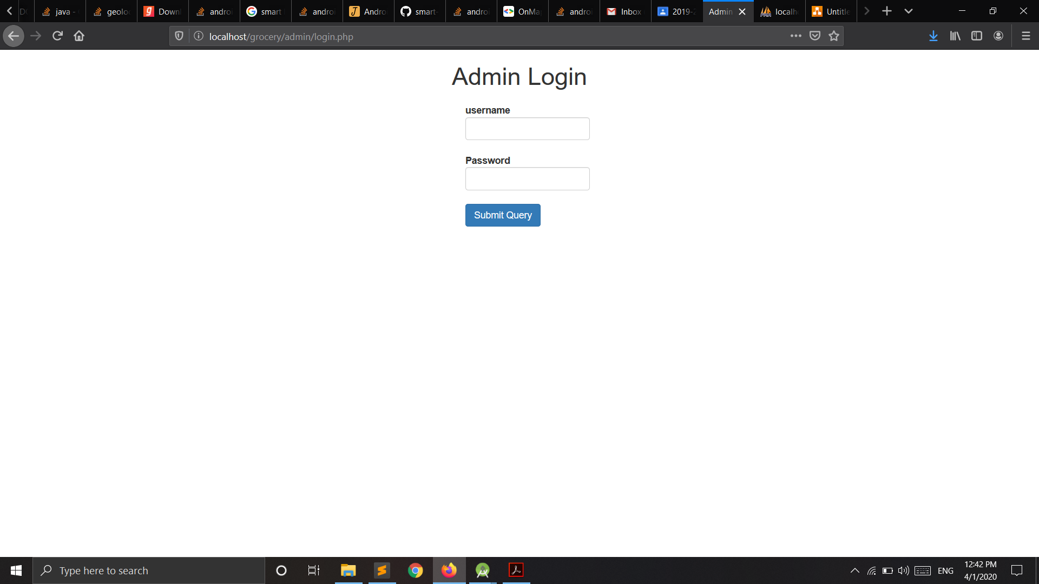
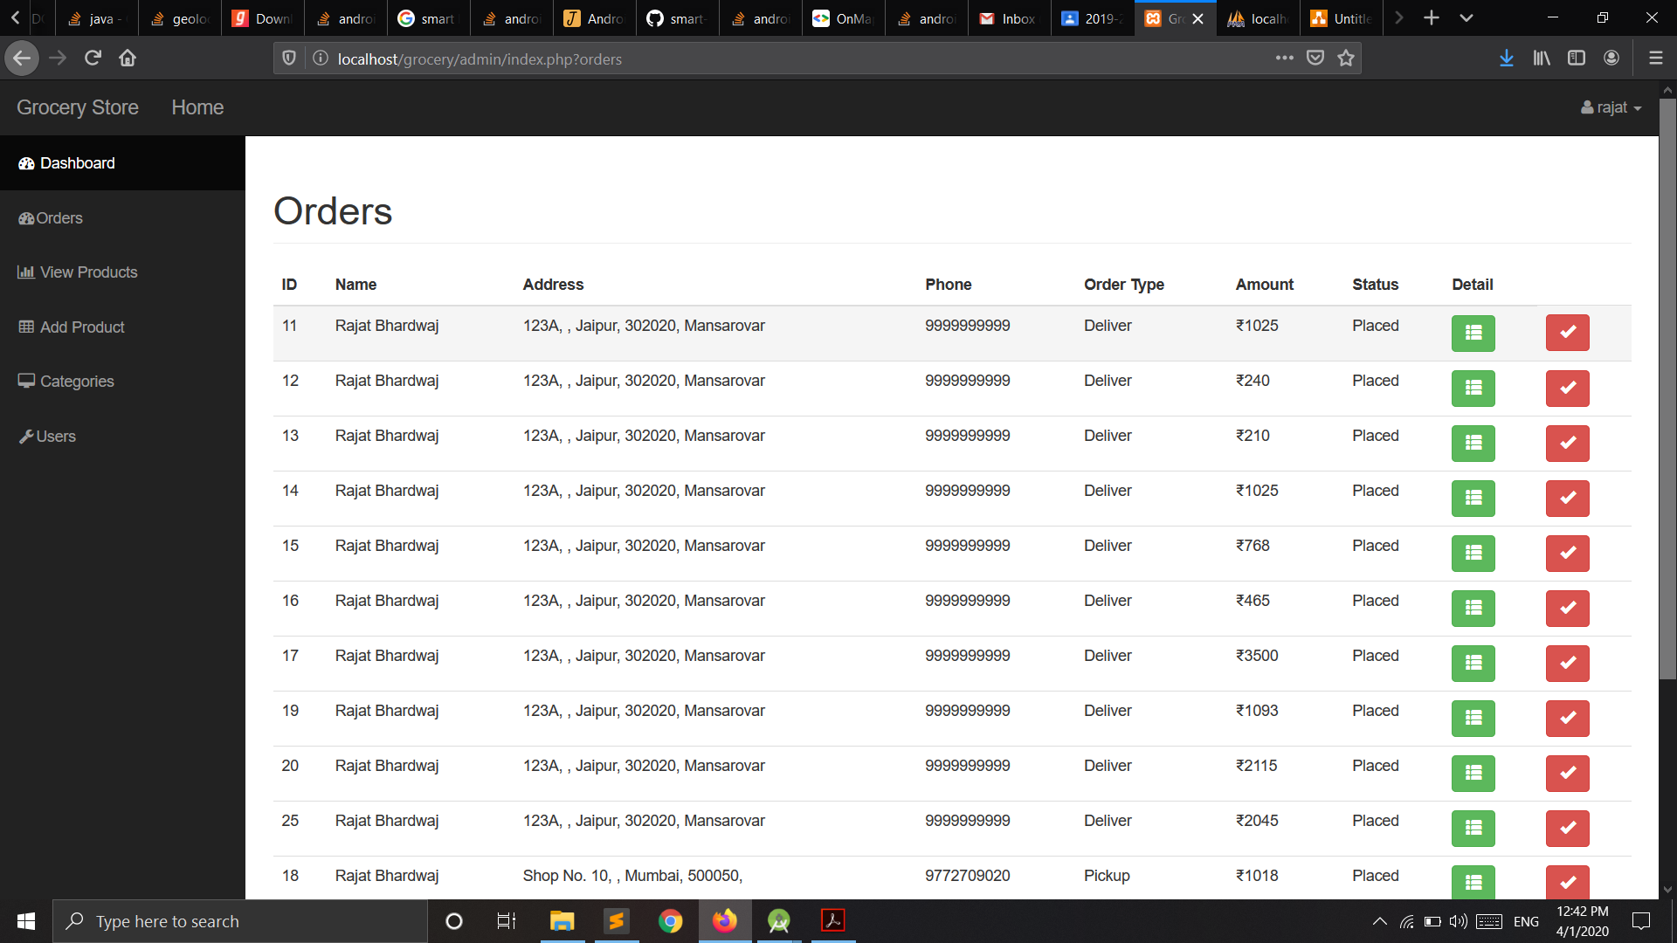
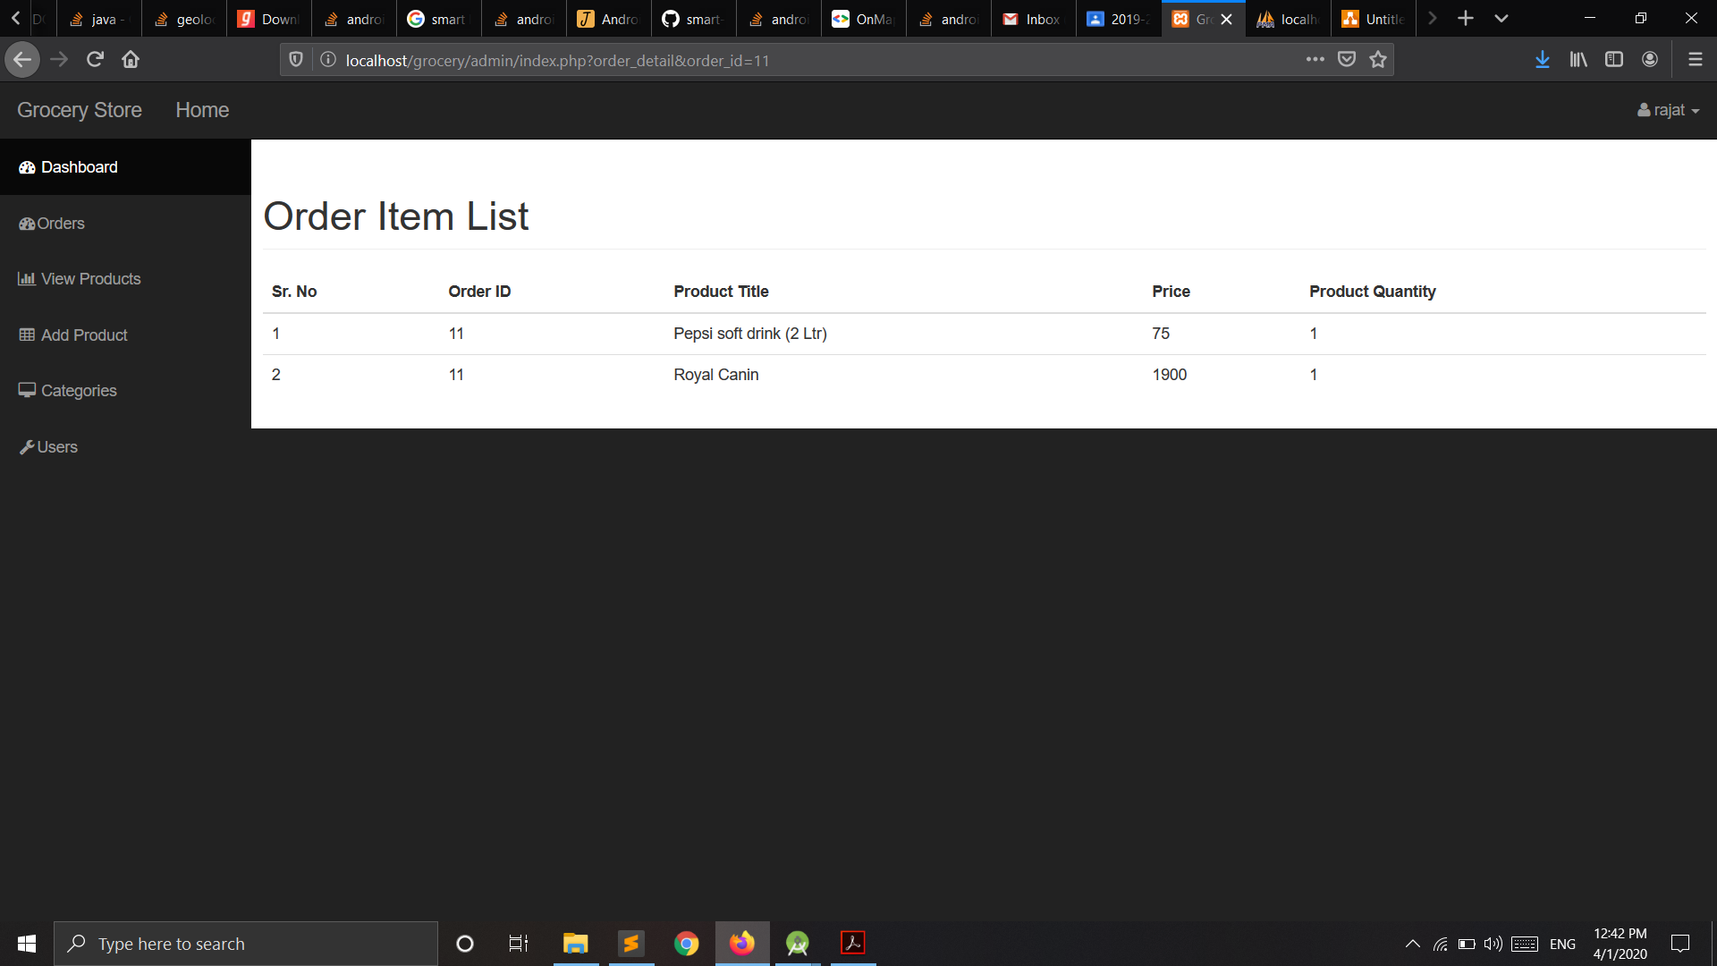

Slide 18
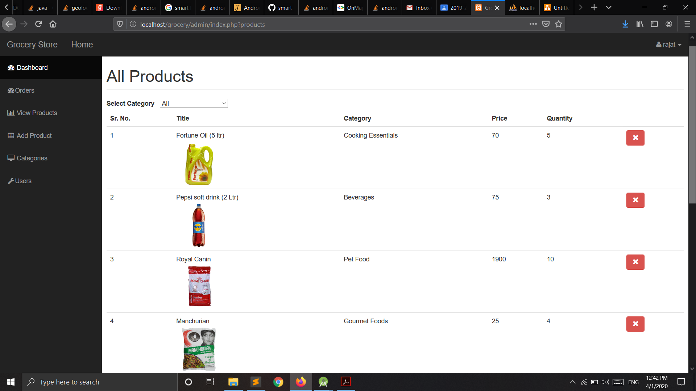
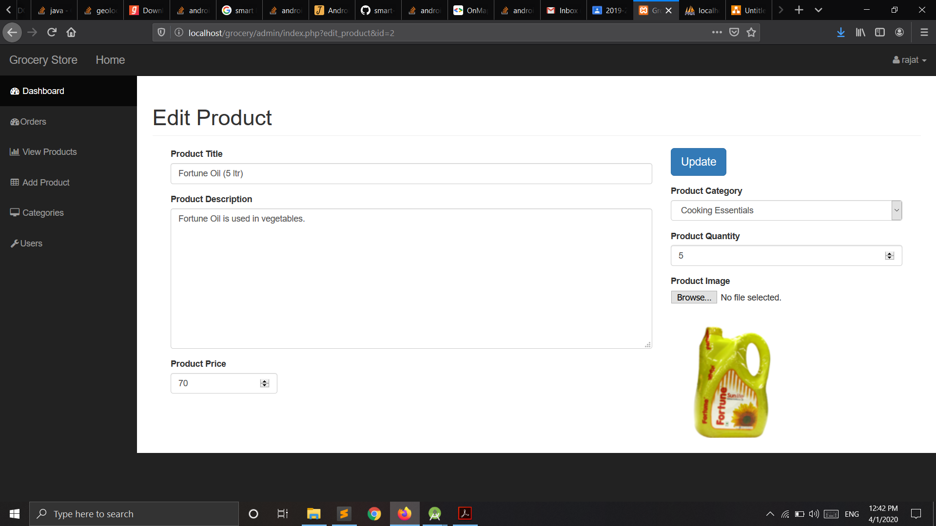
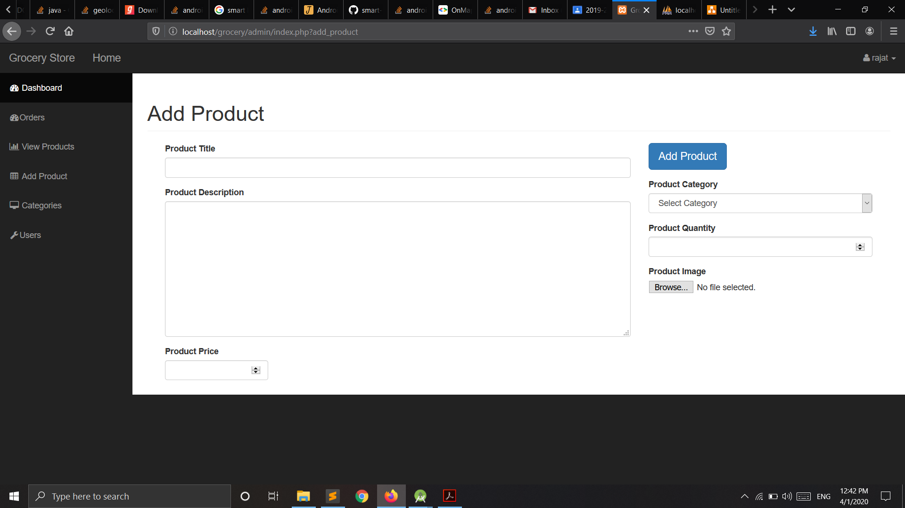
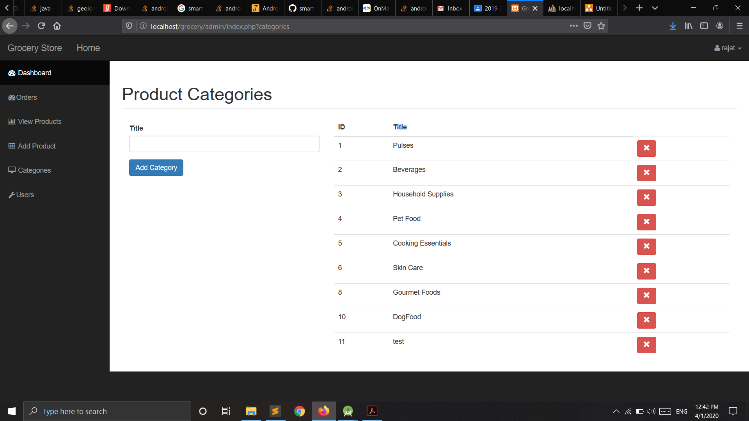

Slide 19
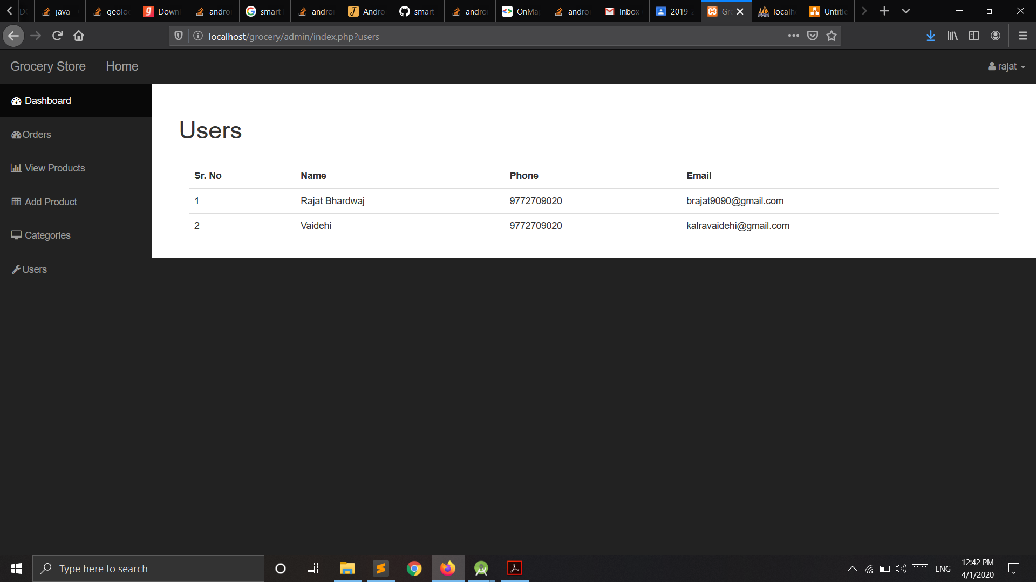
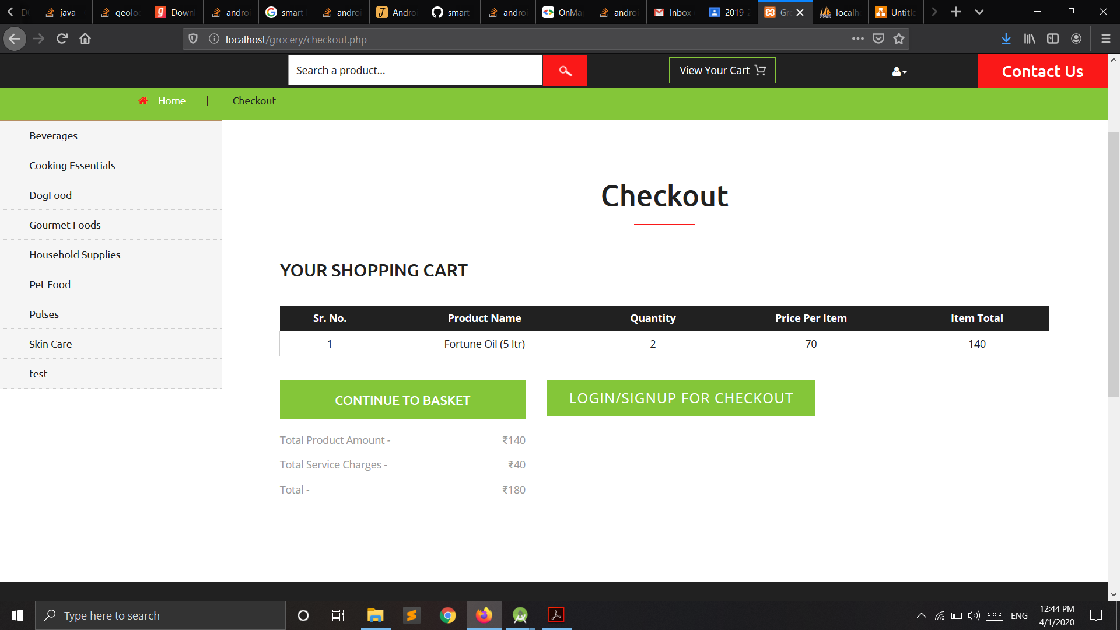

Slide 20
conclusion
When discussing about shopping there has been a great change in the behavior of people in many manners like their attitude, buying pattern. In earlier times people use to do manual shopping but now as time changed people are becoming busy and due to which technology has brought a new revolution i.e. Online Shopping.
All In One Grocery Store is a web application that provides various types of groceries at one place.
The basic idea of this website is to satisfy all the grocery needs of customers at a single place.
Our work is mainly focused on making the users life as easy as possible.
By using the All in One Grocery application a user can save their time, resources.
It provides services for both self-pickup and at-home delivery. So, a person choose according to his own requirements.
Online shopping has a great future but to be successful it is necessary to spread awareness about it’s benefits.

Slide 21
THANK YOU

